Slide 1
COMP 41400 Multi-Agent Systems (MAS) Lectures 7 & 8: Coordination
Professor Gregory O’Hare,
Principal Investigator CONSUS (Crop OptimisatioN through Sensing, Understanding & viSualisation),
School of Computer Science
University College Dublin (UCD)

Slide 2
Coordination
"The process by which an agent reasons about its local actions and the (anticipated) actions of others to try and ensure that the community acts in a coherent manner.”
Nick Jennings,1996

Slide 3
Coordination Ingredients
The act of coordinating;
Achieving proper order or a working relationship;
Harmonious interaction as a function or part thereof;

Slide 4

Why Coordinate?
Preventing anarchy or chaos
Dependencies between agents’ actions.
Need to meet global constraints
No individual has sufficient competence, resources or information to solve the entire problem.
Efficiency

Slide 5
Cooperative Problem Solving
1.
Problem
decomposition
2.
Subproblem
solution
3.
Answer
synthesis

Slide 6
Cooperative Problem Solving
How to break a problem down into a set of atomic sub-problems:
Identify a minimal set of atomic operations that can be performed by individual agents.
Repeatedly decompose the initial problem.
Issues:
What is an appropriate level of granularity?
How to decompose the problem?
Who should decompose the problem?
Who should solve the sub problems?
1. Problem
Decomposition

Slide 7
Cooperative Problem Solving
Solving individual sub-problems.
Sub-problems are allocated in the previous phase.
Sub-problems may have dependencies.
Agents assigned sub-problems may need to share information.
Issues:
How to get help?
Who to share information with?
What information to share?
2. Subproblem
Solution

Slide 8
Cooperative Problem Solving
Combining the results
Solutions to atomic sub-problems are combined to provide solutions to higher-level sub-problems.
Partial solutions may be assembled during this process.
Issues:
Who does the solution synthesis?
How are the sub-problems combined?
Where are the sub-problems combined?
3.Answer
Synthesis

Slide 9
How to Coordinate?
There are two common forms of coordination:
Task sharing:
When a problem is decomposed into subproblems and allocated to different agents.
Result sharing:
When agents share information relevant to their subproblems.
Task 1
Task 1.1
Task 1.2
Task 1.3
A1
A2
A3

Slide 10
Task Sharing
The agent decomposes the task into a set of sub-tasks that are assigned to agents:
The tasks are assigned dynamically at run-time based on agents capabilities.
The task allocation process can be done:
through a central coordinator (manager) that is authorised to assign tasks to worker agents.
through some form of coordination mechanism that allows peers to reach agreement as to who will do what (e.g. negotiation, distributed planning, ...).
Task 1
Task 1.1
Task 1.2
Task 1.3

Slide 11
Result Sharing
Problem solving proceeds by agents cooperatively exchanging information as the solution is developed.
The set of tasks are pre-assigned at design time
Results may be shared:
proactively - one agent sends another agent some information because it believes that the other will be interested in it.
reactively – an agent sends information to another in response to a request.
A1
A2
A3
Notes:
Result sharing is used in blackboard systems.

Slide 12
Result Sharing
A Result Sharing system’s performance can take advantage of:
Confidence: Higher confidence in a result if multiple agents independently derive it.
Completeness: Sharing local views can help to achieve a better global view.
Precision: Individual agents are able to refine their result based upon the results of the other agents.
Timeliness: If the agents work together to formulate the solution in parallel, the result can be attained quicker.

Slide 13
Question
Traffic Management:
A community of agents exist that monitor the level of traffic on a road network.
Individual agents are responsible for pre-defined area of the road network.
When an agent detects a build up of traffic in its area, it contacts a pre-assigned traffic management agent.
Mobile Computing:
A personal agent (located on a users PDA) requests a map centred around the users coordinates that shows nearby hotels.
The map request is sent to a pre-assigned map-broker agent who then contacts an appropriate “map agent” to get the basic map and an appropriate “restaurant agent” to get a list of nearby restaurants and their coordinates.
Are these examples of coordination? If so, what type?

Slide 14
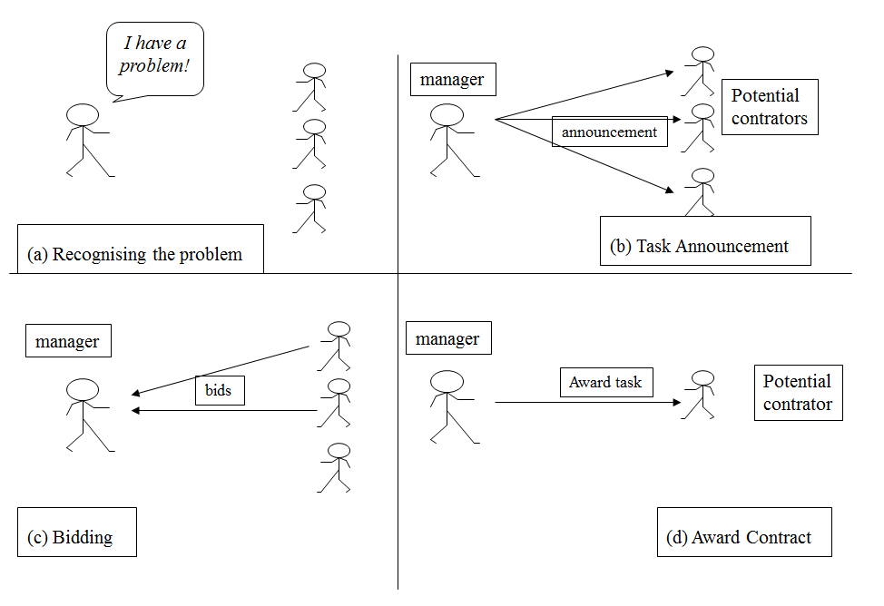
The Contract Net Protocol
A well known protocol for task sharing is the Contract Net Protocol.
It is commonly broken down into 5 key stages:
Recognition
Announcement
Bidding
Awarding
Expediting

Slide 15
Stage 1: Recognition
In this stage, an agent recognizes it has a problem it wants help with.
An agent has a goal, and either…
realizes it cannot achieve the goal in isolation — does not have the capability
realizes it would prefer not to achieve the goal in isolation (typically because of solution quality, deadline, use of resources, etc.)
I have a problem!
(a) Recognising the problem

Slide 16
Stage 2: Announcement
In this stage, the agent with the task sends out an announcement of the task which includes a specification of the task to be achieved.
Specification must encode:
Description of the task itself
Any constraints (e.g. deadlines, quality constraints)
Meta-task information (e.g. preference on attributes)
The announcement is then broadcast
manager
Potential
contrators
announcement
(b) Task Announcement

Slide 17
Stage 3: Bidding
Agents that receive the announcement decide for themselves whether they wish to bid for the task
Factors:
agent must decide whether it is capable of expediting task
agent must evaluate the cost of making the task and the benefits it can get from making it
If an agent chooses to bid, then it submits a tender, detailing the conditions on which it can execute the task
manager
bids
(c) Bidding

Slide 18
Stage 4: Awarding & Expediting
The agent that sent the task announcement must choose between bids & decide who to “award the contract” to
The result of this process is communicated to the agents that submitted a bid
The successful contractor then expedites the task.
That may involve generating further manager-contractor relationships: sub-contracting
manager
Award task
Potential
contrator
(d) Award Contract

Slide 19
The Contract Net
The collection of nodes (agents) is the “contract net”
Each node on the network can, at different times or for different tasks, be a manager or a contractor
When a node gets a composite task (or for any reason can’t solve its present task), it breaks it into subtasks (if possible) and announces them (acting as a manager), receives bids from potential contractors, and then awards the job.

Slide 20
Implementation Issues
How to…
… specify tasks?
… specify quality of service?
… select between competing offers?
… differentiate between offers based on multiple criteria?

Slide 21
Optimisations
Focused addressing: when general broadcast isn’t required
Agents could automatically learn which are the most appropriate nodes for common tasks
Directed contracts: when manager already knows which node is appropriate
For instance when a very similar task has already been done in the past
Proactive Offers: when a node thinks a manager might need a task performed
The nodes can make proactive offers to potential managers of the kind of tasks they are able to execute

Slide 22
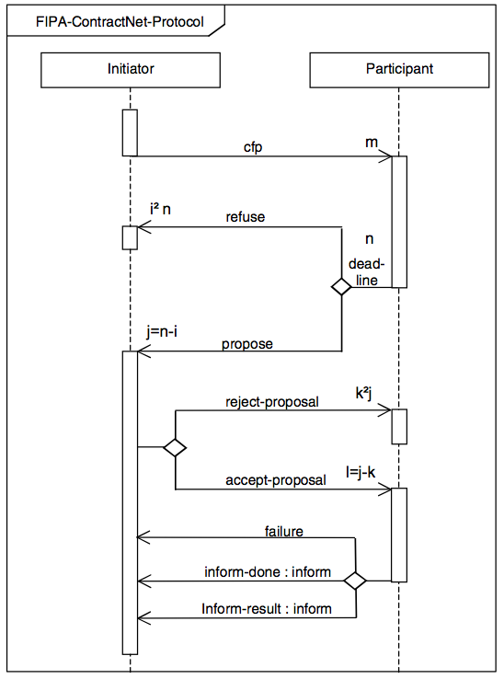
The Contract Net Protocol

Slide 23
Handling Inconsistency
Inconsistencies can occur in cooperative systems.
Agents do not share common objectives.
No single agent has a global view of the system.
Cooperating agents may have incompatible belief sets.
Sensory apparatus may be faulty or return erroneous data.
Potential Solutions:
Don’t let it happen (or ignore it): In Contract Net based systems, it is the managers view of the problem that matters.
Resolve inconsistencies through bargaining: Agents try to overcome the inconsistency by discussing the problem – in practice, this leads to message explosion.
Building systems that degrade gracefully in the presence of inconsistency: Design systems that are aware of inconsistencies and attempt to handle them.

Slide 24
Functionally Accurate Systems
Nodes cooperatively exchange and integrate partial, tentative high-level results to construct a consistent and complete solution.
Problem solving is not constrained to a particular sequence of events - it progresses opportunistically and incrementally.
Agents exchange high-level intermediate results rather than by exchanging raw data.
Uncertainty and inconsistency is resolved when partial results are exchanged and compared with other partial solutions.
The solution is not constrained to a single solution route – any potential solution is accepted.

Slide 25
Coordination Example
Consider an interaction between two robots, A and B, operating in a warehouse.
Each robot has been designed by a different manufacturer.
They both have the capability to stack and unstack boxes that contain goods which have been stored in the building.
Because both robots work concurrently, they need to coordinate their actions to share the work load and to avoid knocking into each other and dropping the boxes.

Slide 26
Coordination Example
Task Sharing:
Our warehouse agents agree a distribution of work and then go about that work.
Robot A works on the east side of the building.
Robot B works on the west side.
Result Sharing:
Agents keep each other informed of their current activities and decide what to do independently.
Robot A decides to move box number A10456.
Robot A tells Robot B.
Using this additional information, Robot B independently decides to move another box A20987.

Slide 27

Things to Do!
Read the original Smith and Davis paper here:
http://www2.cs.siu.edu/~hexmoor/classes/CS539-F12/CNP.pdf
Visit the FIPA definition of the protocol and understand how it works
http://www.fipa.org/specs/fipa00029/SC00029H.html
An interesting norm-based extention to CNP is found here
http://ieeexplore.ieee.org/document/5222886/

